Slide 1
Selective Export of MicroRNAs via Extracellular Vesicles

Slide 2
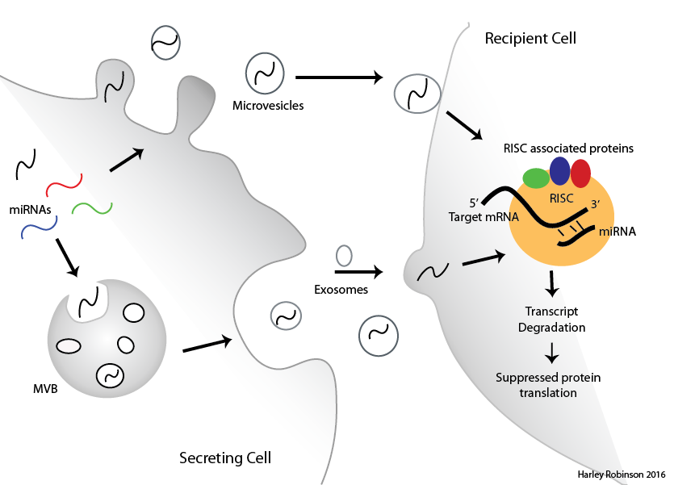
MicroRNAs in Extracellular Vesicles
EVs transfer cellular material between cells
MicroRNAs regulate RNA degradation
Sorting of microRNAs to EVs evident but mechanism not known

Slide 3
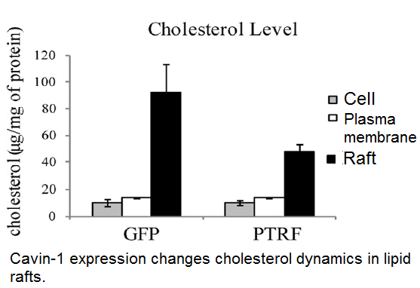
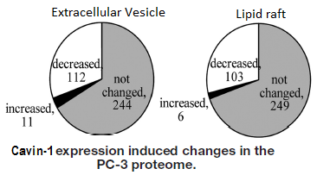
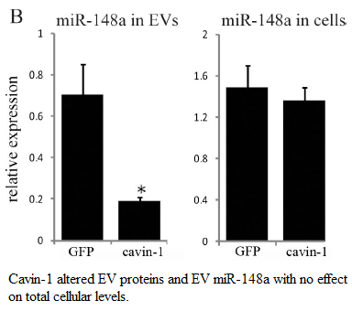
PC3 cell line.
Caveolin-1 expression: No Cavin-1 expression.
Addition of cavin-1 to these cells attenuates:
Oncogenic behaviour
Cholesterol re-distribution
MicroRNA EV content.

Slide 4
Aims and Hypotheses:
Identify the selectively exported miRNAs.
Identify candidate miRNA escort proteins.
Verify candidate miRNA escort proteins ability to bind to miRNAs and transport to extracellular vesicles.

Slide 5
Selectively Exported MiRs.
RNA-seq for small RNAs by Illumina in triplicate for GFP and cavin-1 cell lines AND in exosome and cell.
R package: DEseq2
Filter, normalise, compare between cell lines then between cellular localisation.
Only 95 MiRs.
9 miRs of interest

Slide 6
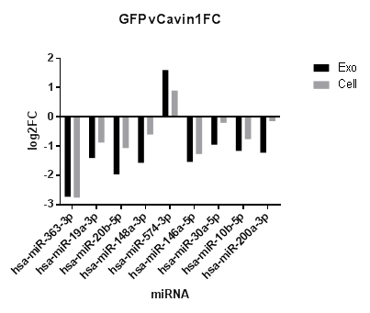
Selectively Exported MiRs.
Consistent trend.

Slide 7
RNA-binding proteins and Motifs.
TAMO software suite: combines several different algorithms to identify motifs, evaluate enrichment and map motifs to sequences.

Slide 8
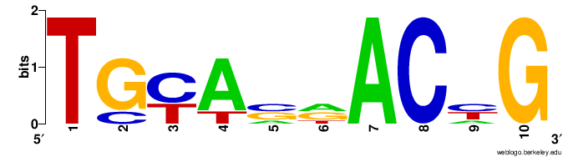
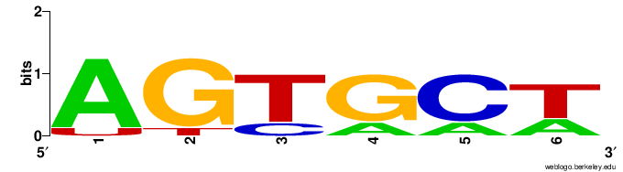
Shared motifs found Differentially exported Mir
Sequence logos and networks.
Info about proteins that appear to correlate to these proteins.

Slide 9
Proteins correlate to differential export.

Slide 10
Aims:
Identify the selectively exported miRNAs
Identify RNA-binding proteins correlated to the miRNA export
Verify candidate miRNA escort proteins ability to bind to miRNAs and transport to extracellular vesicles.

Slide 11
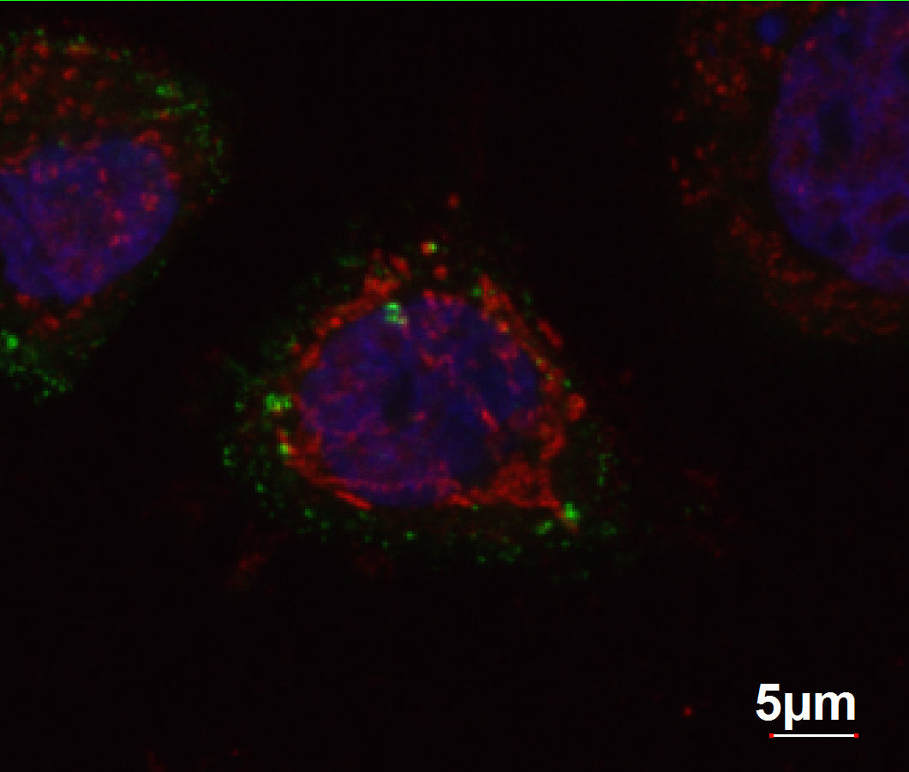
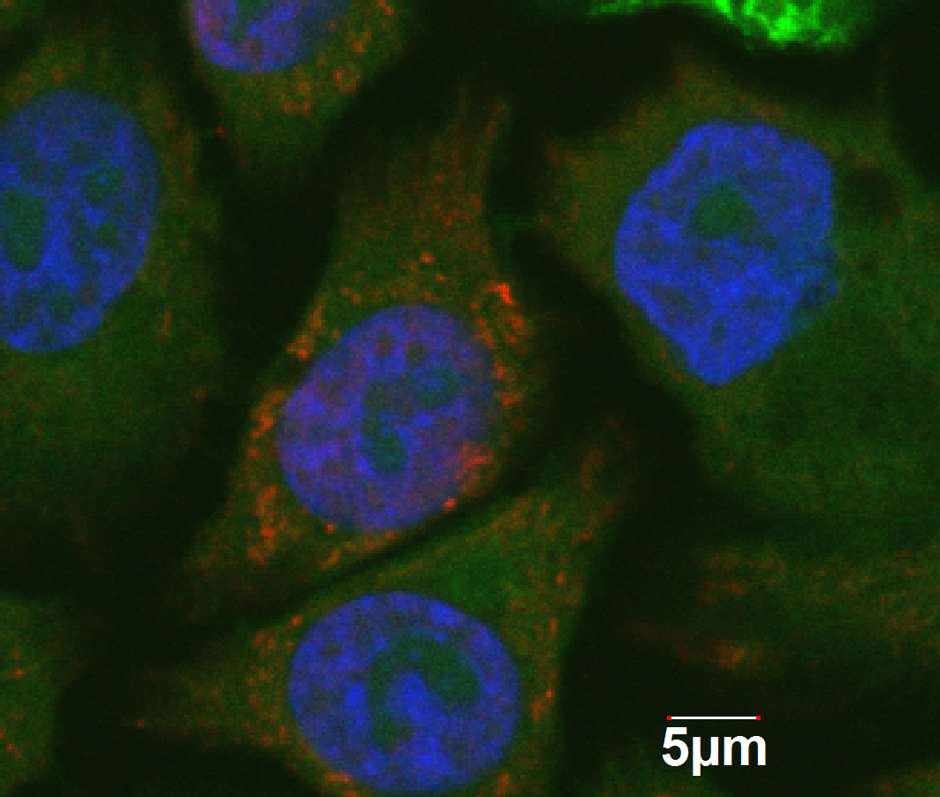
Westerns and Immunofluorescence:

Slide 12
To Do:
Confirm miRNA-Protein interaction via pull down/Western/MS
Determine importance of Sumoylation on the proteins.
In vitro colocalization between protein and miRNA (using Cy5-oglio)

